Slide 1
Spoofing

Slide 2
Why Spoof?
By convincing a computer or a network that he is a trusted party, attacker can get access.
Types of Spoofing
  IP spoofing
  Email spoofing
  Web spoofing

Slide 3
IP Spoofing
Attacker
From address: 10.10.20.30
To address: 10.15.5.5
10.50.50.50
Computer A
Computer B
Reply sent to 10.10.20.30
10.10.20.30
10.15.5.5
Attacker can send packets with a spoofed address
Attackers does not receive any packets back
Flying blind attack or one-way attack

Slide 4
IP Spoofing
From address: 10.10.20.30
To address: 10.15.5.5
Attacker sees reply
Computer A
Attacker
Computer B
Reply sent to
10.10.20.30
10.10.20.30
10.50.50.50
10.15.5.5
Attacker can send packets with a spoofed address
Attackers can pull of the replies

Slide 5

Filtering at Routers
rest of
Internet
local network
(e.g., home network)
10.0.0/24
10.0.0.1
10.0.0.2
10.0.0.3
Datagrams with source or
destination in this network
have 10.0.0/24 address for
source, destination

Slide 6
Routing
routers: no state about end-to-end connections
  no network-level concept of “connection”
packets forwarded using destination host address
  packets between same source-dest pair may take different paths
application
transport
network
data link
physical
application
transport
network
data link
physical
1. Send data
2. Receive data

Slide 7
Routing Table
223.1.1.2
223.1.1.1
223.1.1.4
223.1.1.3
B
223.1.9.2
223.1.7.0
Routing Table At this Router?
223.1.9.1
223.1.7.1
A
223.1.8.1
223.1.8.0
C
223.1.2.6
223.1.3.27
223.1.2.1
223.1.2.2
223.1.3.1
223.1.3.2

Slide 8
Routing Table
223.1.1.2
223.1.1.1
223.1.1.4
223.1.1.3
Dest. IP/Mask Next Hop
223.1.1.0/24 B
223.1.3.0/24 C
223.1.2.0/24 D
B
223.1.9.2
223.1.7.0
223.1.9.1
223.1.7.1
A
223.1.8.1
223.1.8.0
C
223.1.2.6
223.1.3.27
D
223.1.2.1
223.1.2.2
223.1.3.1
223.1.3.2

Slide 9
Longest prefix matching
Prefix Match Link Interface
11001000 00010111 00010 0
11001000 00010111 00011000 1
11001000 00010111 00011 2
otherwise 3

Slide 10
Source Routing
Specifies the path a packet takes
Loose Source Routing
  Sender specifies a list of IP addresses that the traffic must go through
  Traffic can go through any other addresses it needs to
Strict Source Routing
  Sender specifies the exact path
  If exact pat can not be taken, packet is dropped
Source routing helps troubleshooting

Slide 11
IP datagram format
IP protocol version
number
32 bits
total datagram
length (bytes)
header length
(bytes)
head.
len
type of
service
ver
length
for
fragmentation/
reassembly
“type” of data
flgs
fragment
offset
16-bit identifier
max number
remaining hops
(decremented at
each router)
time to
live
upper
layer
Internet
checksum
32 bit source IP address
upper layer protocol
to deliver payload to
32 bit destination IP address
Options (if any)
E.g. timestamp,
record route
taken, specify
list of routers
to visit.
data
(variable length,
typically a TCP
or UDP segment)

Slide 12
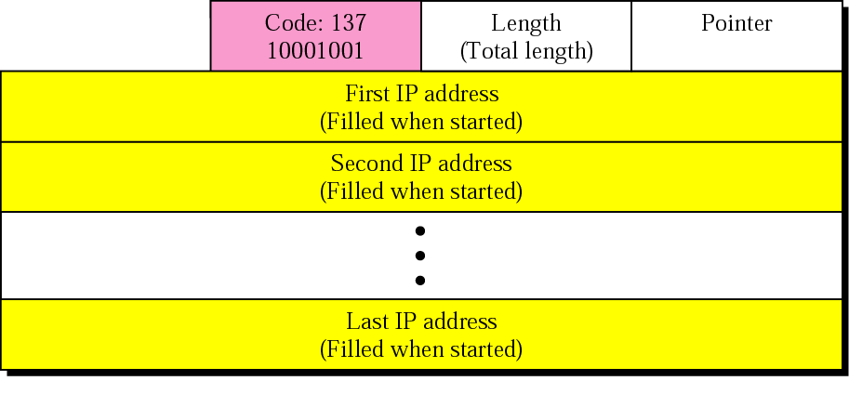
Source Routing

Slide 13
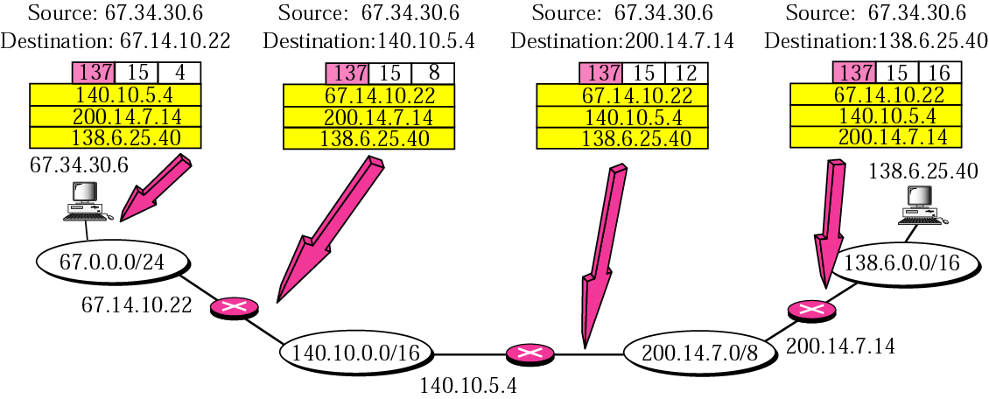
Source Routing

Slide 14
Source Routing
Attacker sends a packet using spoofed address
  Uses loose source routing
  Puts his IP address in the list
Recipient responds
  Packet goes through the attacker’s machine
  Packet goes back to spoofed address
Protection
  Disable source routing
  Cisco routers have enable/disable option

Slide 15
Electronic Mail
outgoing
message queue
user mailbox
user
agent
Three major components:
user agents
mail servers
simple mail transfer protocol: SMTP
User Agent
mail reade
composing, editing, reading mail messages
e.g., Eudora, Outlook, elm, Netscape Messenger
outgoing, incoming messages stored on server
mail
server
user
agent
SMTP
mail
server
user
agent
SMTP
SMTP
mail
server
user
agent
user
agent
user
agent

Slide 16
Electronic Mail: mail servers
user
agent
Mail Servers
mailbox contains incoming messages for user
message queue of outgoing (to be sent) mail messages
SMTP protocol between mail servers to send email messages
  client: sending mail server
  “server”: receiving mail server
mail
server
user
agent
SMTP
mail
server
user
agent
SMTP
SMTP
mail
server
user
agent
user
agent
user
agent

Slide 17
Electronic Mail: SMTP [RFC 2821]
uses TCP to reliably transfer email message from client to server, port 25
direct transfer: sending server to receiving server
three phases of transfer
  handshaking (greeting)
  transfer of messages
  closure
command/response interaction
  commands: ASCII text
  response: status code and phras

Slide 18


Alice sends message to Bob
1) Alice uses UA to compose message and “to” bob@someschool.edu
2) Alice’s UA sends message to her mail server; message placed in message queue
3) Client side of SMTP opens TCP connection with Bob’s mail server
4) SMTP client sends Alice’s message over the TCP connection
5) Bob’s mail server places the message in Bob’s mailbox
6) Bob invokes his user agent to read message
1
mail
server
mail
server
user
agent
user
agent
2
3
6
4
5

Slide 19
Email Spoofing
Telnet to port 25 on a mail server
    helo
    mail from: spoofed-mail-address
    rcpt to: person-sending-mail-to
    data
    message followed by the period sign
Do not allow mail relaying
Attacker runs his own mail server
  Attacker’s IP address will be in mail header

Slide 20
HTTP overview
HTTP: hypertext transfer protocol
Web’s application layer protocol
client/server model
  client: browser that requests, receives, “displays” Web objects
  server: Web server sends objects in response to requests
HTTP 1.0: RFC 1945
HTTP 1.1: RFC 2068
HTTP request
PC running
Explorer
HTTP response
HTTP request
Server
running
Apache Web
server
HTTP response
Mac running
Navigator

Slide 21
HTTP overview
Uses TCP:
client initiates TCP connection (creates socket) to server, port 80
server accepts TCP connection from client
HTTP messages (application-layer protocol messages) exchanged between browser (HTTP client) and Web server (HTTP server)
TCP connection closed
HTTP is “stateless”
server maintains no information about past client requests

Slide 22
Web Spoofing
No requirements for registering a domain name.
Attackers set up a web page with same look.
  Record user information such as credit card numbers
  Display an error message.
Protection
  User server-side certificates
    Many users trust sites without certificates
    Windows displays a message

Slide 23
User-server state: cookies
Many major Web sites use cookies
Four components:
  1) cookie header line in the HTTP response message
  2) cookie header line in HTTP request message
  3) cookie file kept on user’s host and managed by user’s browser
  4) back-end database at Web site
Example:
  Susan access Internet always from same PC
  She visits a specific e-commerce site for first time
  When initial HTTP requests arrives at site, site creates a unique ID and creates an entry in backend database for ID

Slide 24
Cookies
client
server
Cookie file
usual http request msg
server
creates ID
1678 for user
ebay: 8734
usual http response +
Set-cookie: 1678
entry in backend
database
Cookie file
usual http request msg
cookie: 1678
amazon: 1678
ebay: 8734
cookie-
specific
action
access
usual http response msg
one week later:
access
Cookie file
usual http request msg
cookie: 1678
cookie-
spectific
action
amazon: 1678
ebay: 8734
usual http response msg

Slide 25
Cookies
Cookies and privacy:
cookies permit sites to learn a lot about you
you may supply name and e-mail to sites
search engines use redirection & cookies to learn yet more
advertising companies obtain info across sites
What cookies can bring:
authorization
shopping carts
recommendations
user session state (Web e-mail)

Slide 26
Session Hijacking

Slide 27
What is Session Hijacking?
After users authenticate they have access as long as they stay connected and active.
Session hijacking is the process of taking over an existing active session.
  Bypass authentication process
  Gain access to a machine
Take the user offline (DoS attack) and hijack session.
Tools for session hijacking are available on the Internet.

Slide 28
Spoofing vs Session Hijacking
In spoofing, attacker pretends to be another user or machine to gain access.
  The real user plays no role in the attack.
In session hijacking, attacker takes over an active session.
  Attacker relies on legitimate user to make a connection and authenticate himself.
  Attacker forces the legitimate user offline.

Slide 29
Example
Bob telnets to server
Bob authenticates to server
Bob
Server
Die
Hi! I am Bob
Attacker

Slide 30
Types of Session Hijacking
Passive
  Attacker hijacks a session
  Watches and records traffic sent back and forth
  Useful for finding out sensitive information
Active
  Attacker finds an active session and takes over
  Force one of the parties offline
  Executes commands on the system

Slide 31
TCP Connection Management
Three way handshake:
Step 1: client host sends TCP SYN segment to server
  specifies initial seq #
  no data
Step 2: server host receives SYN, replies with SYNACK segment
  server allocates buffers
  specifies server initial seq. #
Step 3: client receives SYNACK, replies with ACK segment, which may contain data

Slide 32
TCP segment structure
32 bits
URG: urgent data
(generally not used)
counting
by bytes
of data
(not segments!)
source port #
dest port #
sequence number
ACK: ACK #
valid
acknowledgement number
head
len
not
used
U
Receive window
A
PSH: push data now
(generally not used)
P
R
S
F
# bytes
rcvr willing
to accept
checksum
Urg data pnter
RST, SYN, FIN:
connection estab
(setup, teardown
commands)
Options (variable length)
application
data
(variable length)
Internet
checksum
(as in UDP)

Slide 33
TCP seq. #’s and ACKs
Host A
Host B
Seq. #’s:
  byte stream “number” of first byte in segment’s data
ACKs:
  seq # of next byte expected from other side
  cumulative ACK
User
types
‘C’
Seq=42, ACK=79, data = ‘C’
host ACKs
receipt of
‘C’, echoes
back ‘C’
Seq=79, ACK=43, data = ‘C’
host ACKs
receipt
of echoed
‘C’
Seq=43, ACK=80
time

Slide 34
Detailed Description of Attack
Find a target
Perform sequence prediction
Find an active session
Guess the sequence number
Take one of the parties offline
Take over the session

Slide 35
Find a target
Find a target
  Servers that allow session oriented connections
  telnet, FTP
Perform Sequence Prediction
  Depends on operating system
  Windows have predictable Sequence numbers
  Linux has hard-to-guess sequence numbers
  Connect multiple times and see how sequence numbers change over time.

Slide 36
Initial Sequence Number
Connection | Windows Client | Linux Server
1 | 2887495515 | 321765071
2 | 2887500502 | 332010905
3 | 2887507109 | 338617656
4 | 2887512311 | 339459049
5 | 2887517117 | 334021331

Slide 37
Find an active session
  Perform attack when there is a lot of traffic
    Choose from many sessions
    Harder to detect
Guess the sequence number
  For communication IP addresses, port numbers and sequence number needed.
  IP addresses and port numbers stay the same during the session.
  If attacker can see all the traffic, no need to guess.
  Assume server expects SN 12345
    Client sends 55555, server will try to re-synch
    Client sends 12345, server accepts the packet and processes

Slide 38
Take one of the parties offline
  Server gets confused if both send packets
  Launch DoS attack against the machine
Take over the session
  Start sending packets to the server and take over the session
  Attacker spoofs source information and sequence number

Slide 39
ACK Storms
If attacker can not guess the SN correctly, ACK storms occur.
Server thinks spoofed packets came from the legitimate user.
Until packet is dropped
Bob
Server
Attacker

Slide 40
Programs that Perform Hijacking
Juggernaut
  Network sniffer.
Hunt
  Listen, intercept and hijack active sessions.
TTY Watcher
  Monitor, hijack connections.
IP Watcher
  Commercial tool to monitor connections.

Slide 41
Dangers posed by hijacking
Most computers are vulnerable
Little can be done to protect against it
Hijacking is simple with proper software
Hijacking is very dangerous

Slide 42
Protection against Session Hijacking
Use encryption
Use a secure protocol
  Ssh instead of telnet, VPN
Limit incoming connections
  Fewer ways an attacker can get into the network
Minimize remote access

